Slide 1
Self-Scoring Worksheet Tutorial
Publicly Owned Housing Program Appropriations Round
Minnesota Housing POHP Staff
mnhousing.gov

Slide 2
Purpose of the Self-Scoring Worksheet
See what Minnesota Housing staff will focus on to determine scores
Help prioritize your scope of work
Provide greater transparency into the scoring process

Slide 3
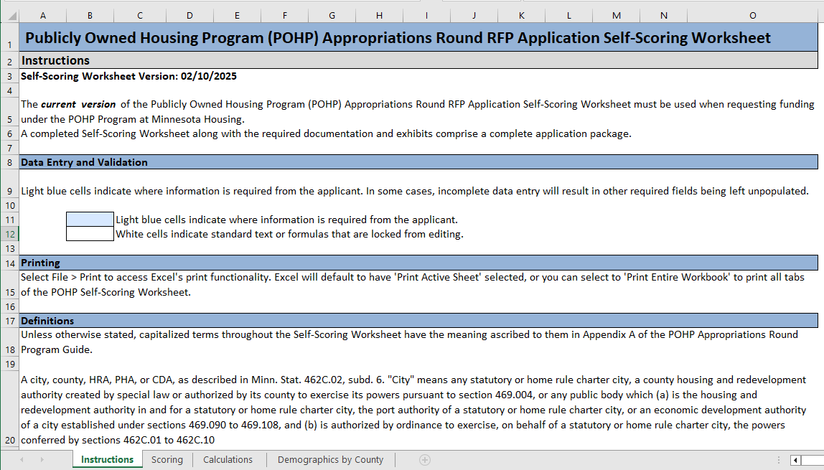
Worksheet Tabs

Slide 4



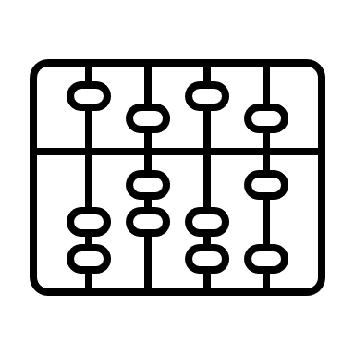

Icon Help
Instruction Tab
Scoring Tab
Calculations Tab
Demographics Tab

Slide 5

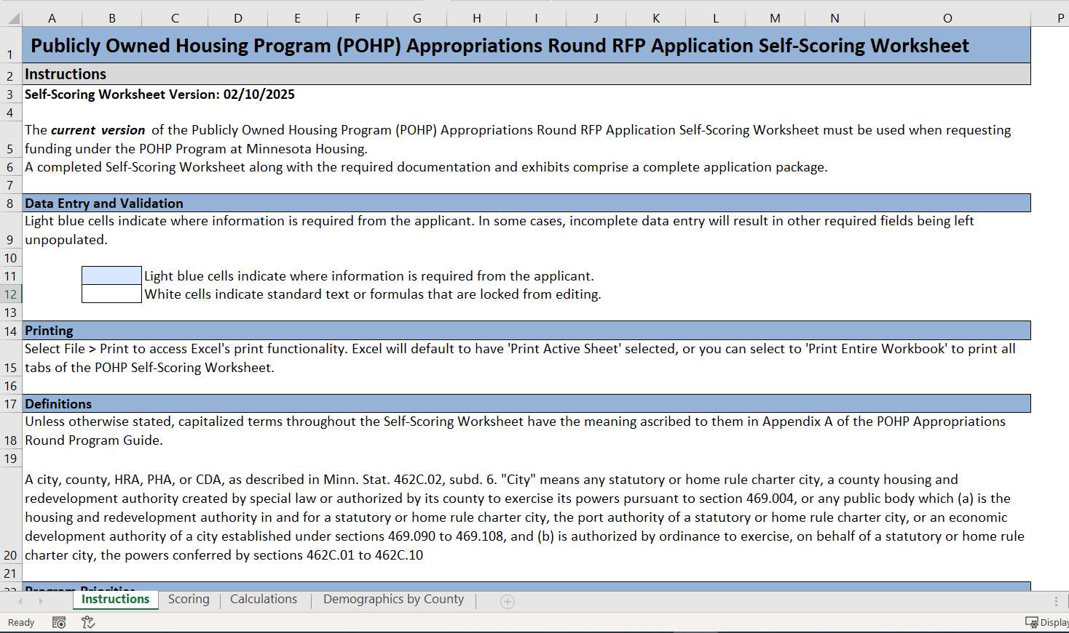
Instruction Tab
How to enter data in the worksheet
How to print the worksheet if desired
Definitions and links for more information on terms used on the Scoring Tab

Slide 6

Scoring Tab
Scoring Tab
Eight sections to complete
General Project and Applicant Information
Threshold Criteria
Program Priorities
Impact and Immediacy
Innovative and Sustainable Design
Proposed POHP Loan Percentage and Non-State Resources/Leverage
Organizational Capacity
Community and Low-Income Renter Household Review

Slide 7
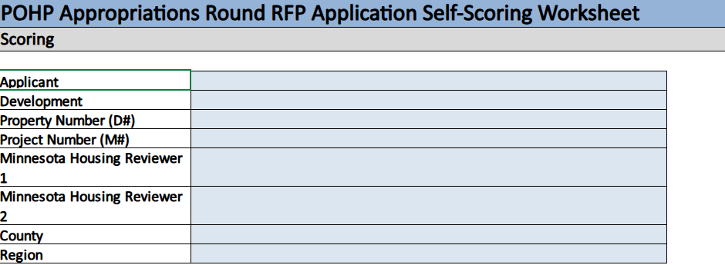
General Project and Applicant Information

Slide 8
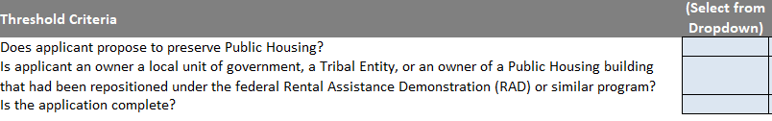
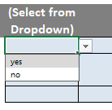

Threshold Criteria

Slide 9
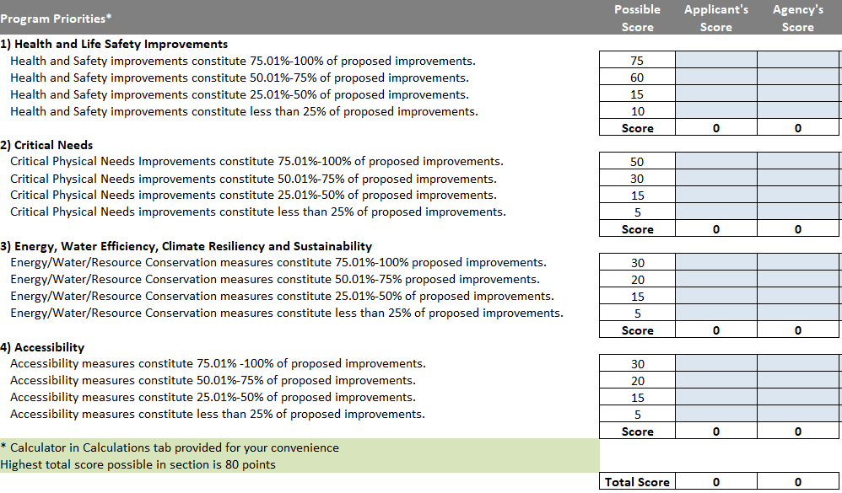
Program Priorities

Slide 10
Program Priorities

Slide 11

Calculations Tab
Optional Help Tab
Sections of Scoring Template that involve a calculation
Program Priorities
Impact and Immediacy
Non-State Resources/Leverage
Low-Income Renter Households in subject Public Housing property

Slide 12
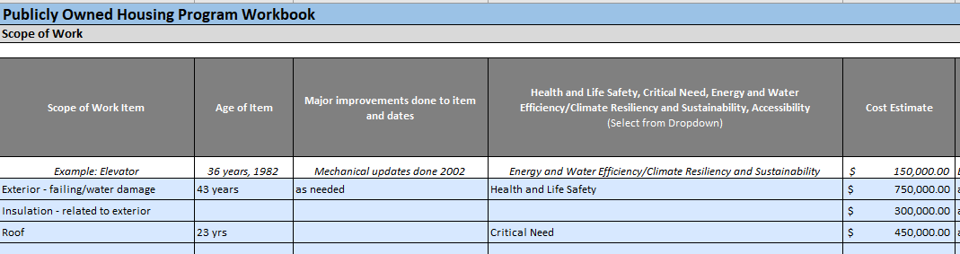
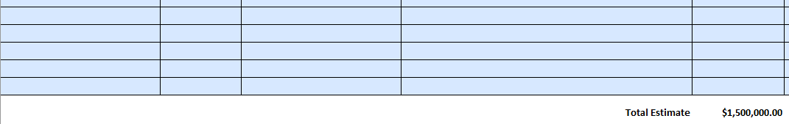
Project Workbook – Scope of Work

Slide 13
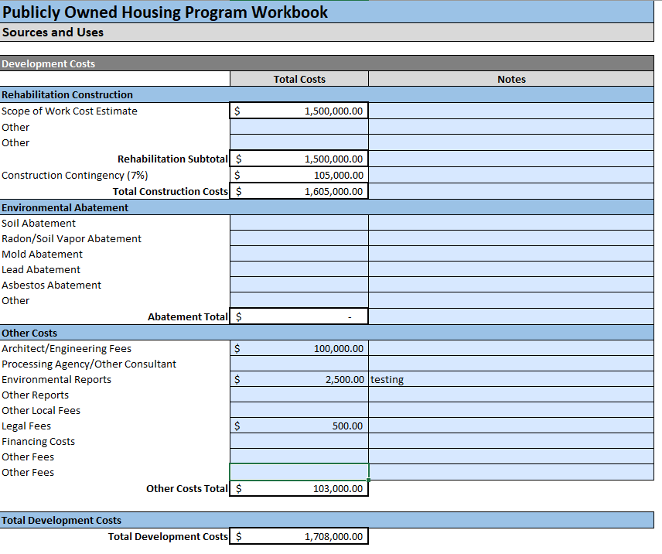
Project Workbook – Development Costs

Slide 14
Project Workbook – Development Costs

Slide 15
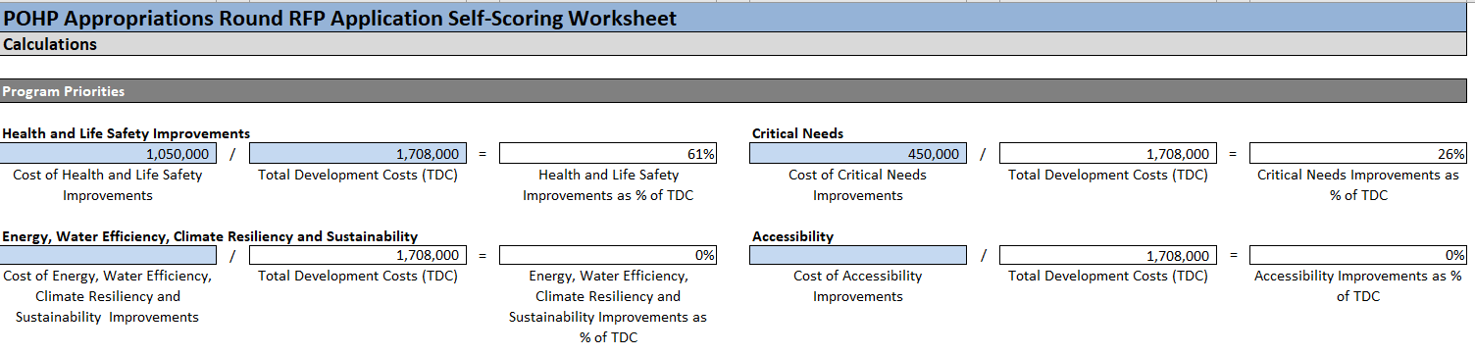
Program Priorities Calculation

Slide 16
Program Priorities Calculation

Slide 17
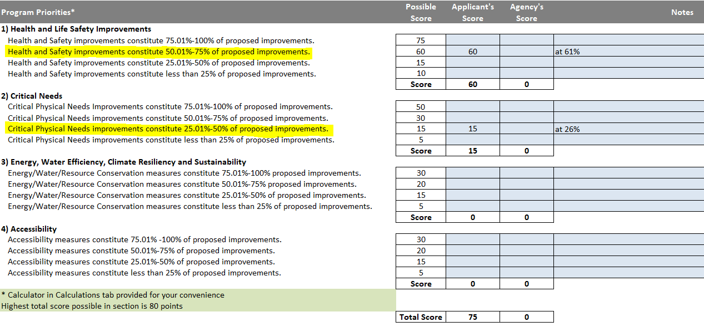
Program Priorities

Slide 18
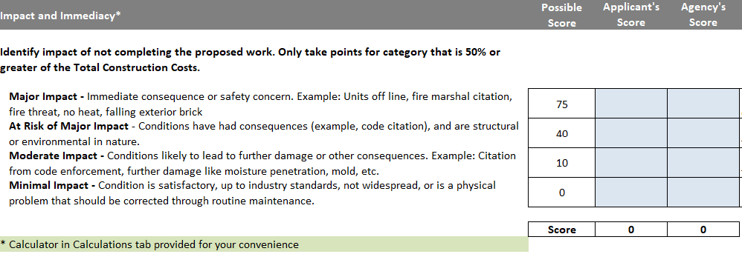
Impact and Immediacy

Slide 19
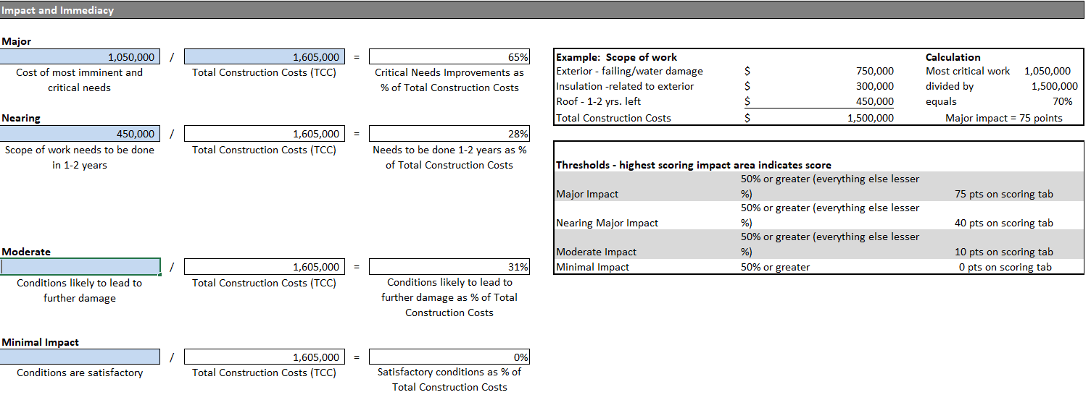
Impact and Immediacy Calculations

Slide 20
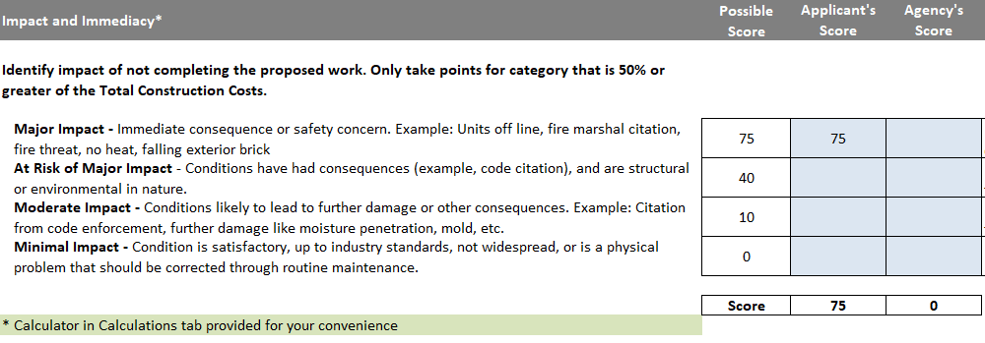
Impact and Immediacy

Slide 21
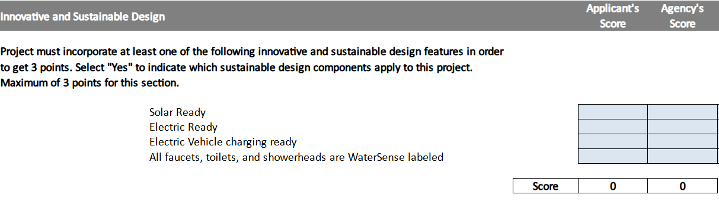
Innovative and Sustainable Design

Slide 22
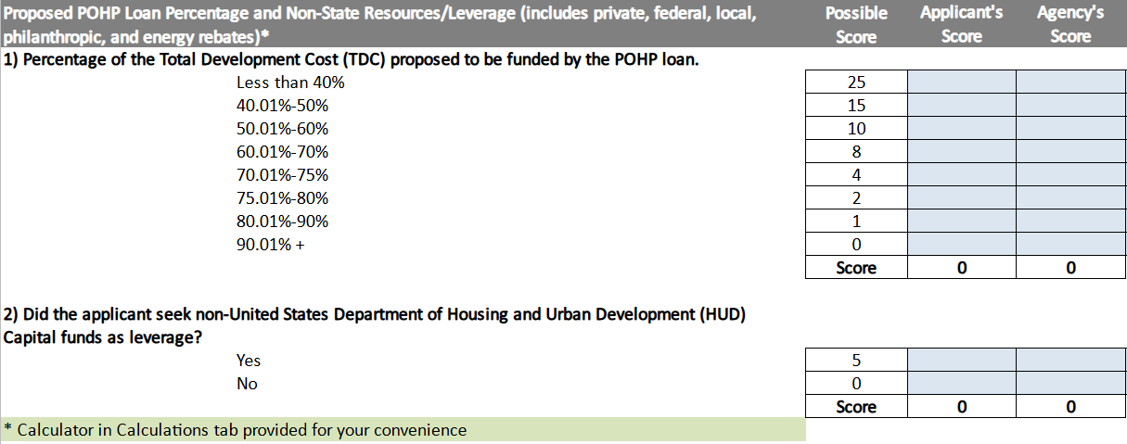
POHP Loan and Non-State Resources/Leverage

Slide 23
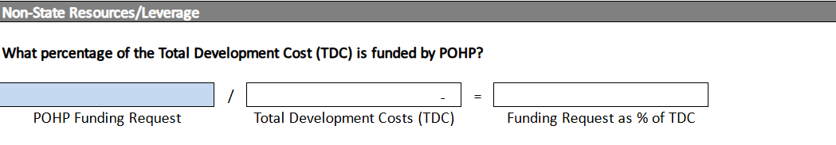
Non-State Resources/Leverage

Slide 24
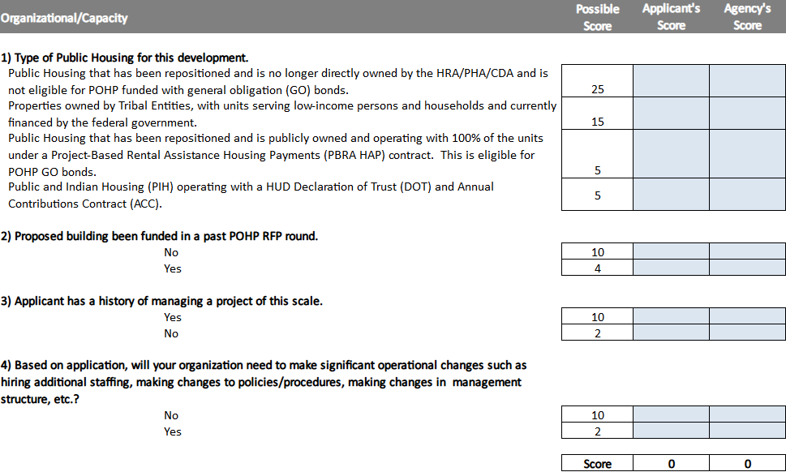
Organizational/Capacity

Slide 25
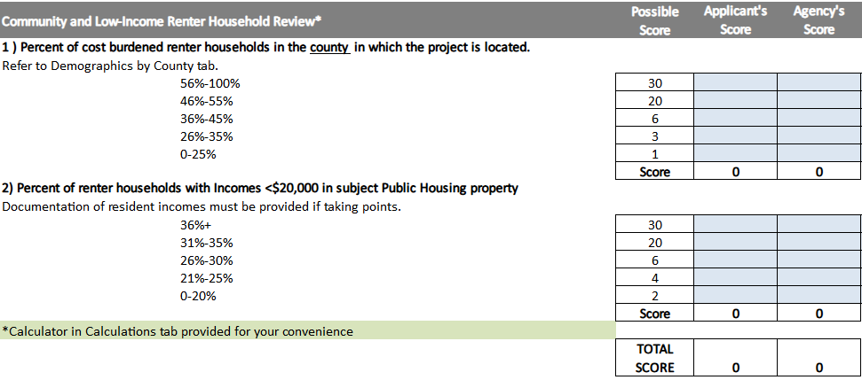
Community and Low-Income Renter Household Review

Slide 26
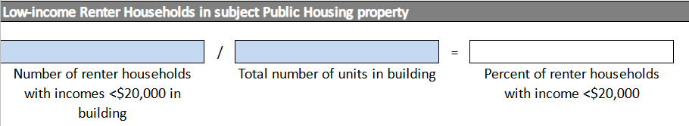
Low-Income Renter Households in subject Public Housing Property

Slide 27

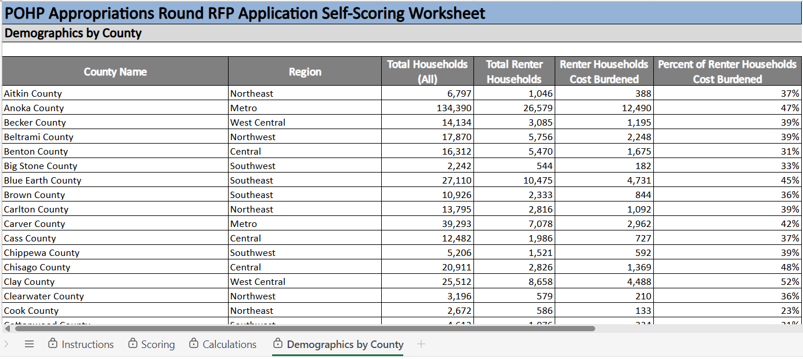
Demographics by County

Slide 28
Thank you!
POHP Self-Scoring Worksheet Tutorial
mnhousing.gov

